Slide 1


Everything You Always Wanted to Know About Doing a Predoctoral Research Stay
but You Were Afraid to Ask
María Navas-Loro
Ontology Engineering Group
Universidad Politécnica de Madrid, Spain
mnavas@fi.upm.es
https://marianavas.oeg-upm.net
2020-03-19
OEG
@

Slide 2

Outline
Outline
Introduction
Grants
Types
Instances
Obstacles in the way
Bricoadvices
Summary
Synergy
* There might be advertising during this presentation

Slide 3



Introduction
Research what?

Slide 4

Lo what?
What is a Research Stay?
You go somewhere to do stuff surrounded by different people than usual.
… holidays?
NO
Why would I do that?
It is cozy at OEG…

Slide 5
Why would I do that?
I want to do research with X, the pope of the field and do synergies.
I like traveling/meeting different cultures/taking fancy selfies.
It is good for the CV/networking.
I need it for the International Mention of the PhD thesis.
I have to do it, it is compulsory in my grant/contract.
I want to work focused on Y without being disturbed by everyday duties.
Everyone should go to Asia at least once in a PhD-time.
ASun told me so.
I need to leave for a while so people do not notice I am an impostor (please, visit a previous presentation by Julia if this applies).
I want to escape from my vane rutine, that lacks of motivation, and run away to a country with no extradition where no one can make me come back.
Bureaucracy looks challenging.
I have nothing better to do.
It is part of my master plan to rule the Universe.
…

Slide 6


Grants
Huge

Slide 7

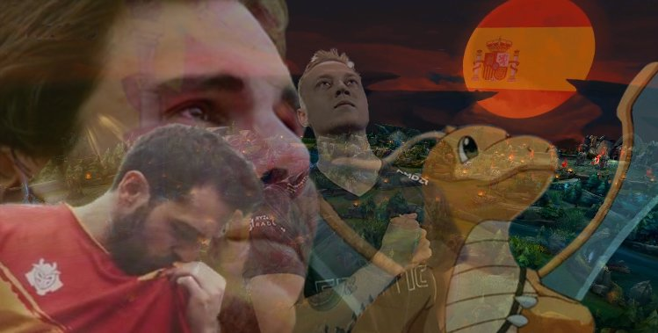

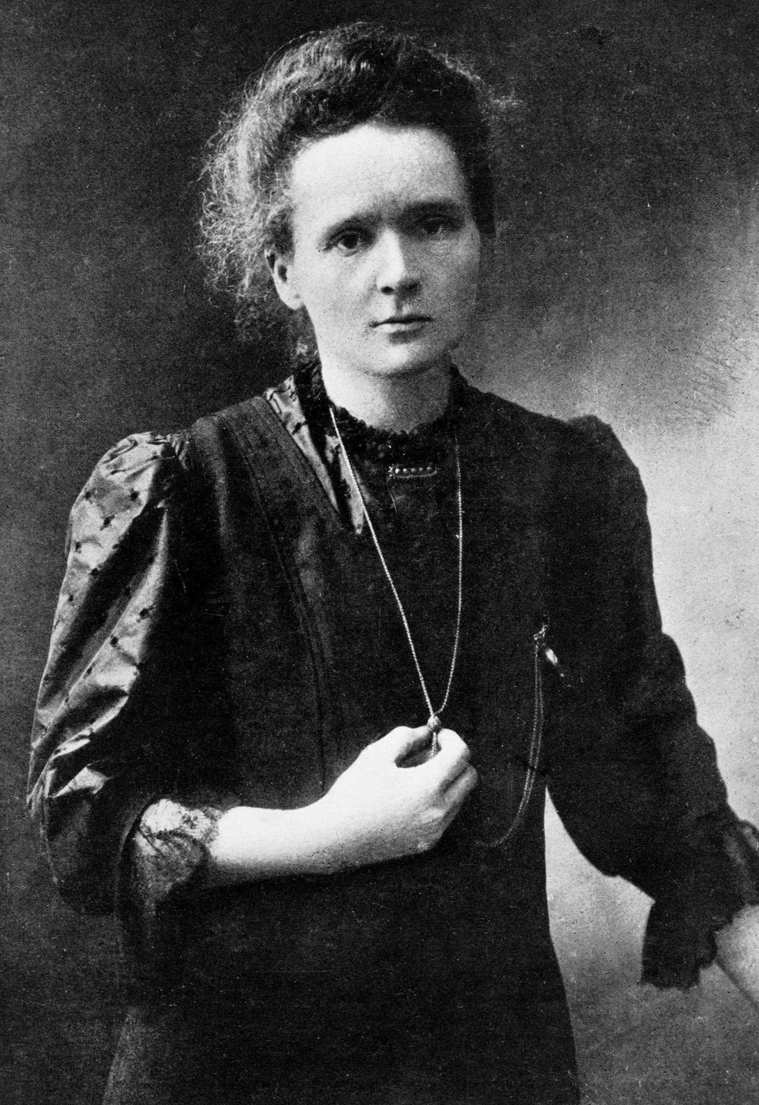


Types of Grants
Grants can come from:
UPM:
Agreements
PIF Grants
Consejo Social (of UPM)
Erasmus+
Host:
Country
Institution
Others:
Projects
Actions (Marie Curie, etc)

Slide 8
Grants
Convocatoria Erasmus+ estudios
(Europe regular ones or KA107 for outside)
Some spots for PhD students.
Duration depends on the destiny.
Travel grant depends on the destiny (around 600e per month).
Usually published around September.
You contact someone in the host institution.
Deadline: December of the preceding year.

Slide 9
Grants
Ayudas para la formación de doctorandos del Consejo Social de la UPM
(3-6 months stay for predoc researchers)
For PhD students.
Always between 3 and 6 months.
Stay ( around 1500 euros per month).
Deadline: September of the previous year.
Stay during a natural year (from January to December)

Slide 10
Grants
Convocatoria de ayudas PIF para realizar Estancias de Investigación Internacional igual o superior a 3 meses
(3-6 months stay for predoc researchers)
For PhD students.
Always between 3 and 6 months
People with the predoc grant has priority (but never full).
Travel grant (500 - 1000 €) + Stay ( max. 1200 € per month).
Can be combined with a grant by the destiny institution.
Deadline: March of the year of the stay (it can be retroactive).
Stay during a natural year (from January to December).
Extra: if you have a FP., you have a dedicated grant!

Slide 11
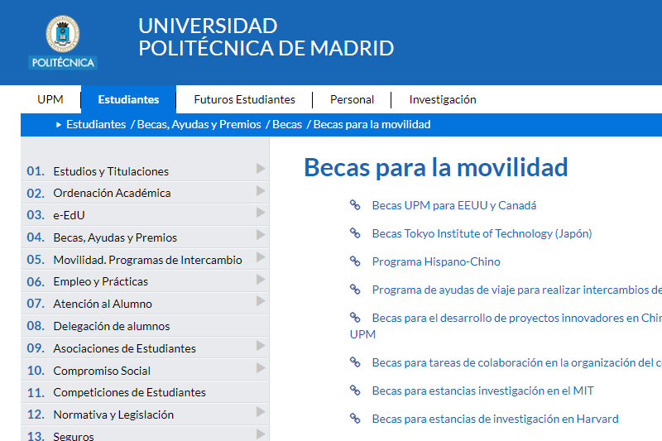

UPM Agreements
Full list:
https://www.upm.es/Estudiantes/BecasAyudasPremios/Becas/Becas_Movilidad
For specific institutions
MIT,
Harvard,
TONGJI …
For specific areas
Iberoamerica (Santander-UPM)
EEUU/Canada …
Recommendations:
Check in advance, previous calls.
Use https://www.followthatpage.com/ (thanks, Julia)

Slide 12
From host institution
NII MOU Grants (NII, Japan)
For PhD students.
December/May every year.
Topics and supervisors list.
Duration depends on the supervisor there (eg, 2/3 months)
University South California (USC, EEUU)
Summer Internship program.
Topics available in the website.
Deadline: February.
Look in the website of your target host!

Slide 13
From host country/other sources
JSPS (Japan)
Competitive (as far as I know).
Very good brochure in the lab.
Check Embassies!
Extra: if you want to visit a University but not to do a research stay, there are a lot of Summer Schools (specially in China, partially funded).
Other sources:
European projects.
MC Actions.
Projects with foreign universities at researcher level.
Foreign universities need minions.

Slide 14


Next steps?
OK, let’s say I try to go for one of those… any recommendation?

Slide 15


IN THE WAY
Obstacles

Slide 16
The timeline
Recommended steps:
READ GRANT CAREFULLY (previous years if none)
Check when is the next DIA meeting, and the grant deadline.
ASK ANY DOUBT
To the official channels, and look for previous holders.
CHOOSE DESTINY
CHECK DATES/CONDITIONS WITH EVERYBODY
Advisor, projects you are working with…
GET OFFICIAL CONFIRMATION FROM HOST
Usually a letter confirming destiny AND DATES
START COLLECTING SIGNATURES
Ask for the next Consejo del DIA, or the President, or whoever you need to sign your document.

Slide 17
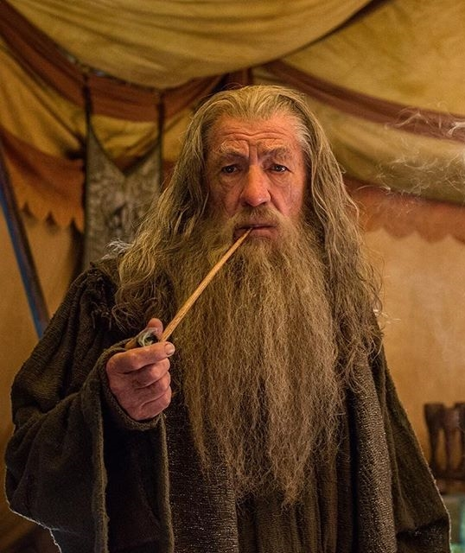
About the Enemy
<< ¡que la locura sea nuestro manto, un velo en los ojos del enemigo! Pues él es muy sagaz y mide todas las cosas con precisión, según la escala de su propia malicia >>
Gandalf

Slide 18
About the Bureaucracy
tenacidad
<< ¡que la locura sea nuestro manto, un velo en los ojos del enemigo! Pues es muy sagaz y mide todas las cosas con precisión, según la escala de su propia malicia >>
la bu-
rocracia
. . .
ine-
ficiencia
>>
ineptitud
Gandalf

Slide 19


Your obstacles
YOUR OWN CONTRACT
Read incompatibilities CAREFULLY.
THE GRANT CALL
Read incompatibilities.
They can change.
Some years NO APPLICATION.

Slide 20

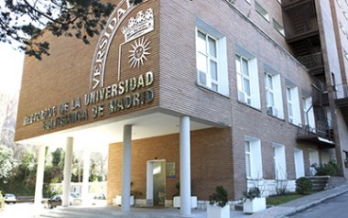
UPM obstacles
THE DEPARTMENT (aka “El DIA”)
DIA signatures.
Time! (at least a month and a half).
RECTORADO
Ask doubts and conditions ASAP.
Pref. By EMAIL.

Slide 21

External obstacles
Country requirements
VISA.
Regulations.
Host institution requirements
Any documentation they require.
Usually send an official email for paperwork.

Slide 22

Once you get it
OK, let’s say I do all this and get a grant… now what?

Slide 23
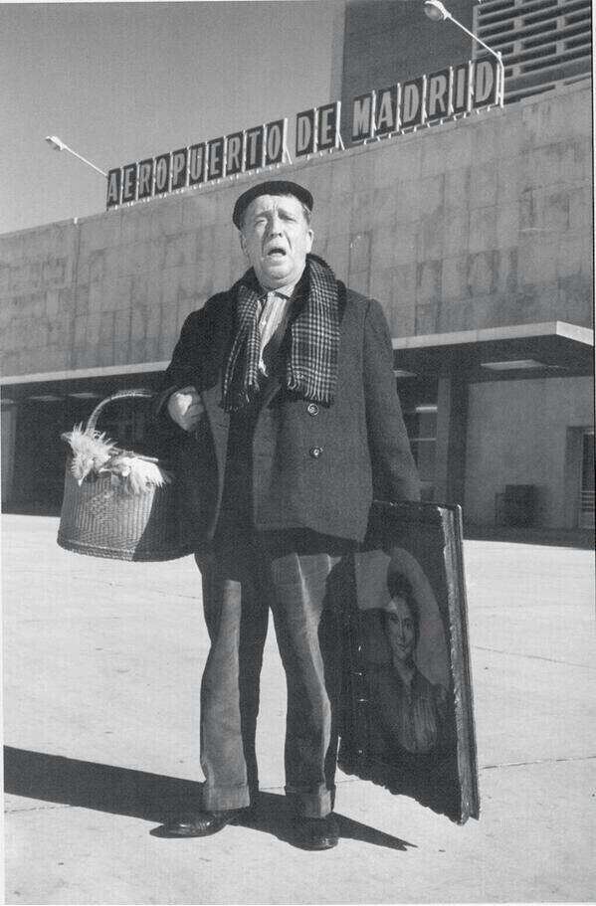
BRICOADVICES
A few

Slide 24


The timeline strikes back
Recommended steps:
Check Bureaucracy
Conditions on dates (day before/after)*
Condition on travel expenses.
Conditions on justification of lodgment.
Lodgment
Travel (sometimes required for getting the first transfer)
Culture/Language
Enjoy!
Come back with all the paperwork you need ☺.
I WILL SUCCED!
* Advice sponsored by
Your lifetime temporal friend

Slide 25
Lodgment
Recommendations:
Ask your host for help:
University facilities.
University agreements.
Recommendations for areas of the city/websites.
Ask people from previous stays (if possible, there).
Check forums.
My advice:
What the host suggests.
Previous grant holders recommendations.
Residences.
AirBNB/others.
AGAIN, check conditions of the grant (sometimes you need invoices).

Slide 26
Research itself
Commonly recommended:
1st year: Do whatever they want in destiny.
2nd/3rd year: Mutual collaboration, on your topic.
3rd/4th: Write thesis.
Non written rule: Who pays, rules:
- If you (UPM, you, home institution) funds, you choose.
- If host institution pays, agreement.
Obviously, the best is to collaborate in something you are interested in.
My advice:
Discuss in advance what to do (Skype, previous collaboration…)

Slide 27
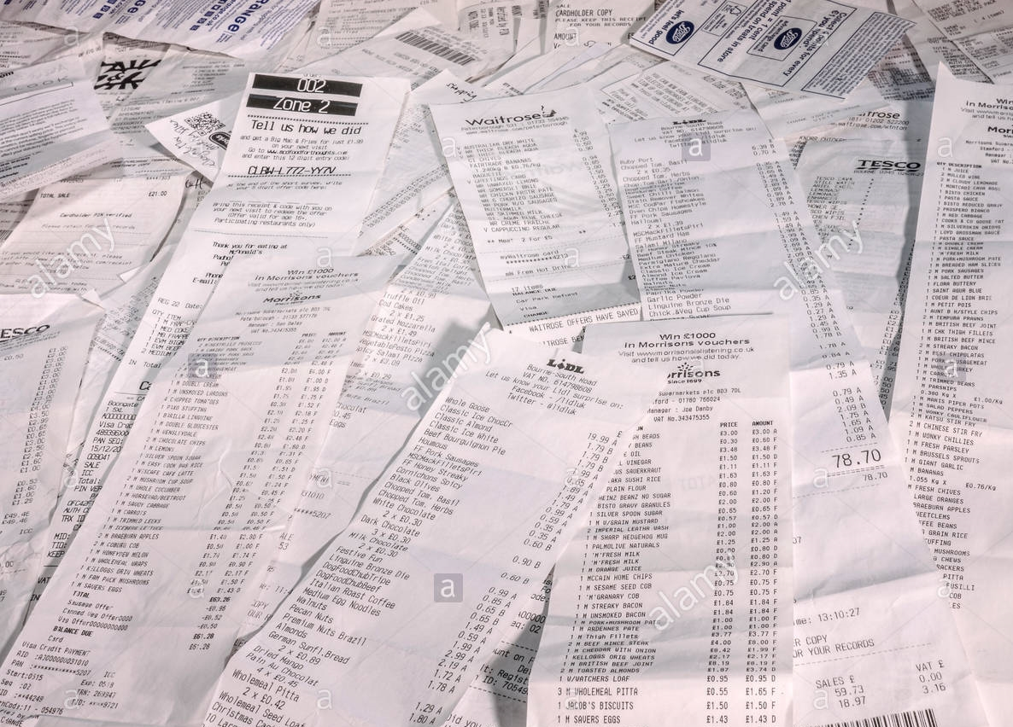
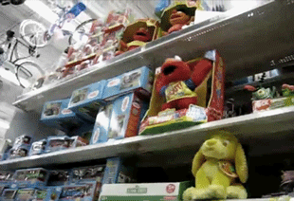
Bureaucracy
Prepare in advance what you need:
Food bills?
Flight tickets?
Local paperwork (eg Vienna).
Certificate signed by host (IN BLUE).
Report with stamp? (always the original!)
Conditions on paper signature / aknowledgments.
Check the deadlines:
Usually X days after the return.
But sometimes also THERE (Erasmus).
ALSO, KEEP ALWAYS THE ORIGINAL REPORTS/CERTIFICATE.

Slide 28
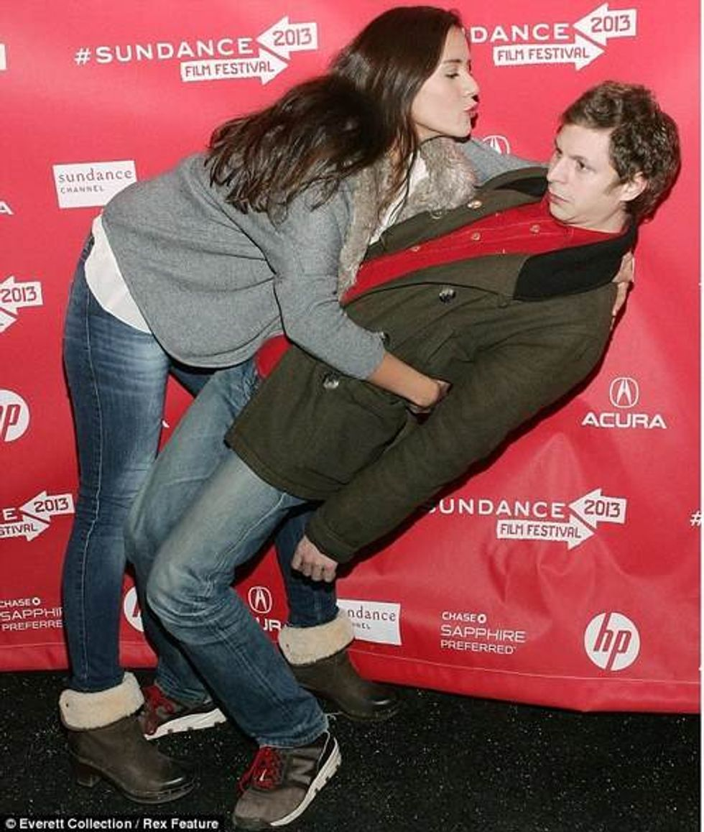

Context
Cultural shocks:
Inform yourself about cultural differences (eg, two kisses).
Try to survive.
Anyway, there are Spaniards/Hispanic-ishs almost everywhere ☺.
Language:
ALWAYS TRY TO LEARN IN ADVANCE.
Even just basics (eg, Japanse syllabaries, basic expressions).

Slide 29
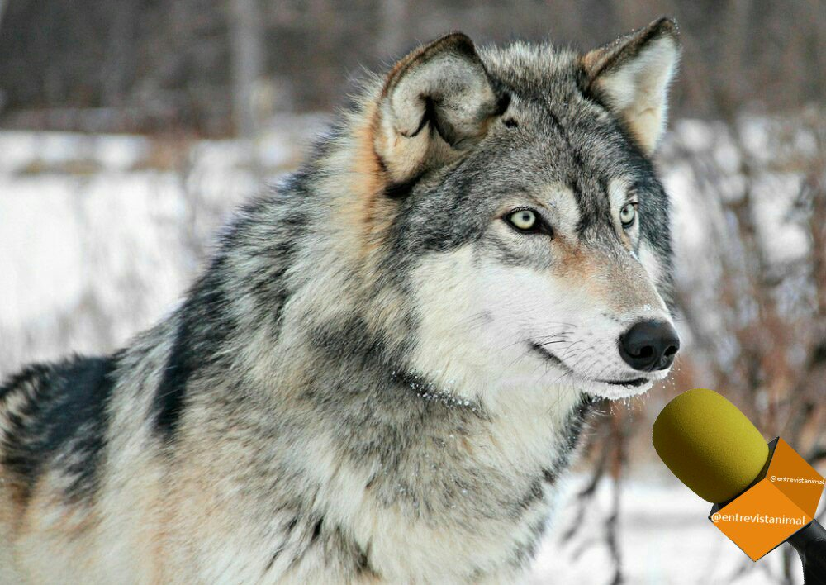
SUMMARY
+ Señor Lobo, ¿qué tal la estancia?
- Lobordao
Conclusions

Slide 30

Summary
Summary:
Be prepared in advance! (and patient).
Check everything carefully.
Don’t be afraid, ASK (or SPAM).
Do preparations ASAP.
Profit the stay (do not bring work from home).
Travel while there.
Learn.
Bring all the paperwork you need.
Bring junk food for JARG.
Don’t let the collaboration die after the stay.
Sign your papers correctly.
Give a presentation about what you did ;)

Slide 31


Thank you for your attention

Slide 32
Everything You Always Wanted to Know About Doing a Predoctoral Research Stay
but You Were Afraid to Ask
María Navas-Loro
Ontology Engineering Group
Universidad Politécnica de Madrid, Spain
mnavas@fi.upm.es
https://marianavas.oeg-upm.net
2020-03-19
OEG
@

